Slide 1

Project Title : ML-Based Crop Health Detection Using CNN
By :
1. Narayan Kishor Adhude
2. Shubham Bhagawan Mhaske
3. Dinesh Anil Kawade
Under The Guidance Of Prof. Y. D. Pawar sir

Slide 2
Agenda :
Introduction
Problem Statement
Objective
Methodology
Technological Stack
Expected Output
Benefits & Future Scope
References
Conclusion

Slide 3
Introduction
Agriculture is a major contributor to the Indian economy.
Plant diseases significantly reduce crop yield and farmer income.
Early detection is critical but requires expert knowledge.
Deep Learning enables automated image-based disease detection.
This project proposes an AI-based Crop Health Diagnostic System.

Slide 4
Problem Statement
Plant diseases are one of the major causes of reduced agricultural productivity and financial loss for farmers. Traditional disease detection methods rely on manual inspection, which requires expert knowledge and is often time-consuming and inaccurate.
In rural areas, access to agricultural experts is limited, leading to delayed diagnosis and improper treatment. Therefore, there is a need for an automated, intelligent, and accessible system that can accurately detect plant diseases at an early stage using leaf images.

Slide 5
Objective :
To develop an AI-based system for automatic detection of plant diseases using leaf images.
To build a user-friendly web application for easy image upload and result display.
To provide detailed information about detected diseases, including causes and treatment solutions.
To integrate frontend, backend, and machine learning components into a complete end-to-end system.
o design a scalable system that can be extended for mobile apps, real-time detection, and cloud deployment in the future.

Slide 6
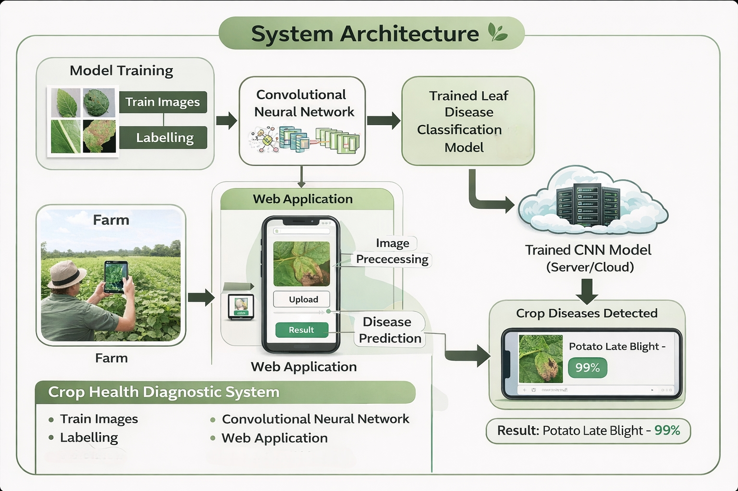
Methodology/Workflow :
The System Follows the Below steps :
Dataset collection and organization
Image preprocessing (Resizing & Normalization)
Model training using Transfer Learning (EfficientNetB4)
Validation and performance evaluation
Disease prediction using trained model

Slide 7
Technical Stack (Technology) :
Frontend
HTML5 – Structure of web pages
CSS3 – Styling and layout
JavaScript (JS) – Client-side interaction
Bootstrap – Responsive UI Framework
Backend
Flask – Python Web Framework(Lightweight)
TensorFlow – Deep Learning Framework
Keras – High-level API for Neural Networks
Platform
Google Colab (GPU Acceleration)
Google Drive
VS Code
Tools and Libraries Used for Model Training:
Dataset
Plant Leaf Image Dataset
61,000+ Images
39 Disease Classes
14 Plants
Folder-Based Structured Dataset
Keras
EffientNetB4
TensorFlow
NumPy
Matplotlib

Slide 8
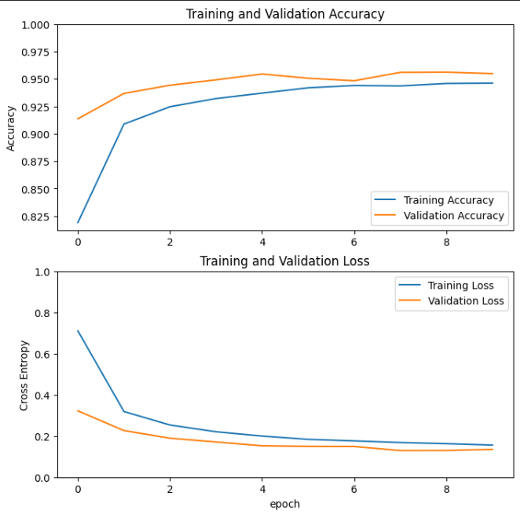
training accuracy and validation loss :

Slide 9
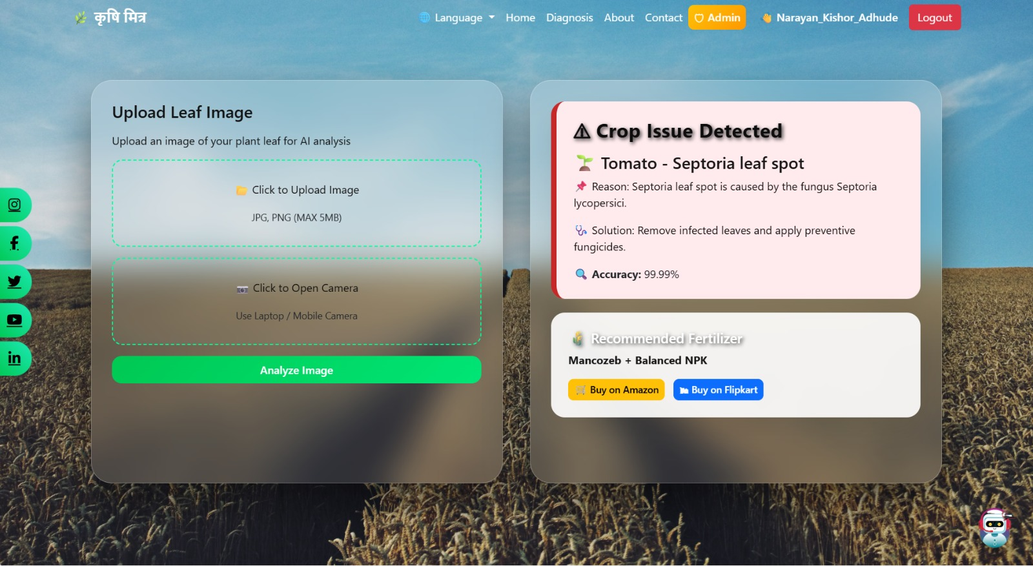
Result :

Slide 10
BENEFITS :
Future Enhancement :
Early detection of plant diseases
Reduces crop loss and financial damage
Supports farmers with fast diagnosis
Minimizes incorrect pesticide usage
Cost-effective and scalable AI solution
Model Accuracy Improvement
Online Deployment
Cloud-Based Dashboard

Slide 11
References :
1. Dataset Used Source: Mendeley Data https://data.mendeley.com/datasets/tywbtsjrjv
2. TensorFlow Official Documentation https://www.tensorflow.org/
3. Keras Documentation https://keras.io/
4. Flask Documentation https://flask.palletsprojects.com/
5. NumPy Documentation https://numpy.org/
6. OpenCV Documentation https://opencv.org/

Slide 12
Conclusion :
In conclusion, this project demonstrates how Artificial Intelligence can be effectively applied in agriculture for plant disease detection. By leveraging transfer learning and a large dataset, we achieved high classification accuracy.
The system is scalable, practical, and capable of supporting farmers in early disease diagnosis, ultimately contributing to improved agricultural productivity.

